Slide 1

House Price Prediction
Hunter Jackson, Matthew Hosier, Aiyana Johnson

Slide 2
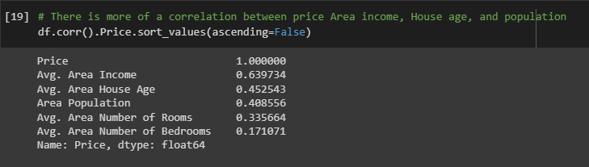
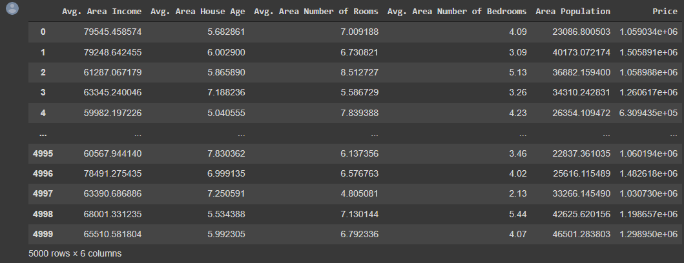
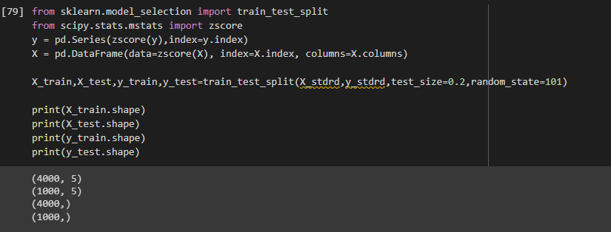
Data summary
Dataset used - USA_Housing.csv
Finding correlation between the most relevant columns of data.
Preprocessing the data into a usable format.
Training and testing the data for the ‘price’ column.
X = 'Avg. Area Income','Avg. Area House Age','Avg. Area Number of Rooms','Avg. Area Number of Bedrooms','Area Population’
Y = 'Price’
Different algorithms used to test the data:
Linear Regression
Ridge Regression
Random Forest Regressor
RANSAC
Compute the error rate from the testing set
Calculate the time efficiency and memory cost

Slide 3
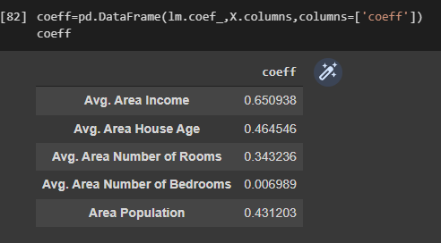
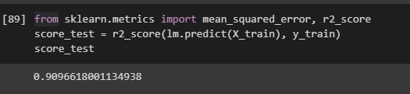
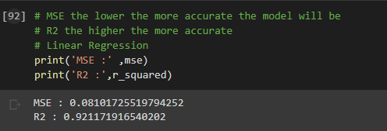
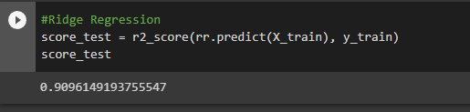
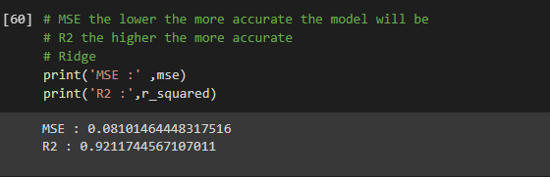
Linear Regression & Ridge Regression
Linear Regression fits a linear model with coefficients w = (w1, …, wp) to minimize the residual sum of squares between the observed targets in the dataset, and the targets predicted by the linear approximation.
R^2 coefficient of determination is a statistical measure of how well the regression predictions approximate the real data points
Ridge regression or Tikhonov regularization is the regularization technique that performs L2 regularization.

Slide 4
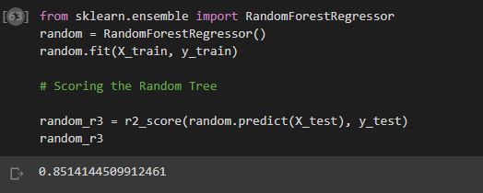
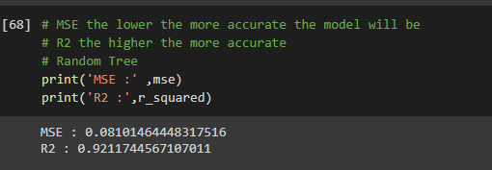
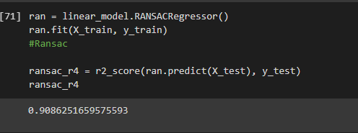
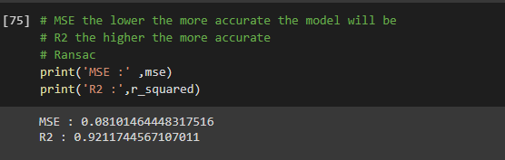
Random Forest Regressor & RANSAC
Random Forest is a meta estimator that fits several classifying decision trees on various sub-samples of the dataset and uses averaging to improve the predictive accuracy and control over-fitting.
RANSAC is an iterative algorithm for the robust estimation of parameters from a subset of inliers from the complete data set.

